Slide 1
Raspberry pi based Home Security system
Group E:
Aniekan Edward Akai
John Khoi Lee
Yuan Sun
Nicholas Golle

Slide 2
Introduction
When away from home, it would nice to be able to keep tabs on the events occurring back home. Our security system does it for you.
The Home Security System is constantly monitoring the home for any unexpected entry or motion, at any sign of motion detected by the PIR sensor, the home owner is notified of a break in and a picture from the video feed from the camera is sent to him/her.
The home owner may then take action accordingly.

Slide 3
Hardware components
2 (or more) Raspberry Pi
1 (or more) Pi Cameras
1 (or more) PIR Motion sensors
1 (or more) Speakers
1 Java server

Slide 4
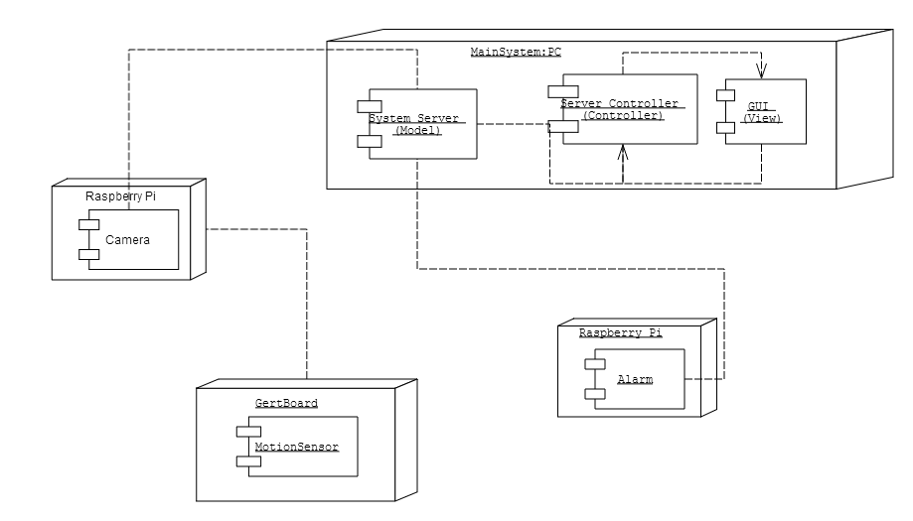
System Architecture – Deployment diagram

Slide 5
System architecture – message protocol Table
Sender | Message(Object class) | Destination | Description
ServerListener | HandshakePacket | AlarmListener CameraListener | Confirms communication with clients. (HandshakePacket.success = true, shows success in receiving connection acknowledgement)
ServerListener | AlertPacket | AlarmListener | Sets off alarm when AlertPacket.alarmOn = true and alarmOn in AlarmListener set to true (and vice versa)
ServerListener | MotorPacket | CameraListener | MotorPacket with Boolean direction defined(such that false = left & true = right) to state the way the camera should move
AlarmListener | AuthenticationPacket | ServerListener | To confirm connection to server
AlarmListener | MessagePacket | ServerListener | Sends the name(stored in MessagePacket.name) for the server to give the AlarmClient & Server connection(It is called “Alarm” at the moment)
CameraListener | AuthenticationPacket | ServerListener | To confirm connection to server
CameraListener | Alert Packet | ServerListener | This alerts the server of the motion detector being triggered
CameraListener | MessagePacket | ServerListener | Sends the name(stored in MessagePacket.name) for the server to give the CameraClient & Server connection(It is called “Camera” at the moment)

Slide 6
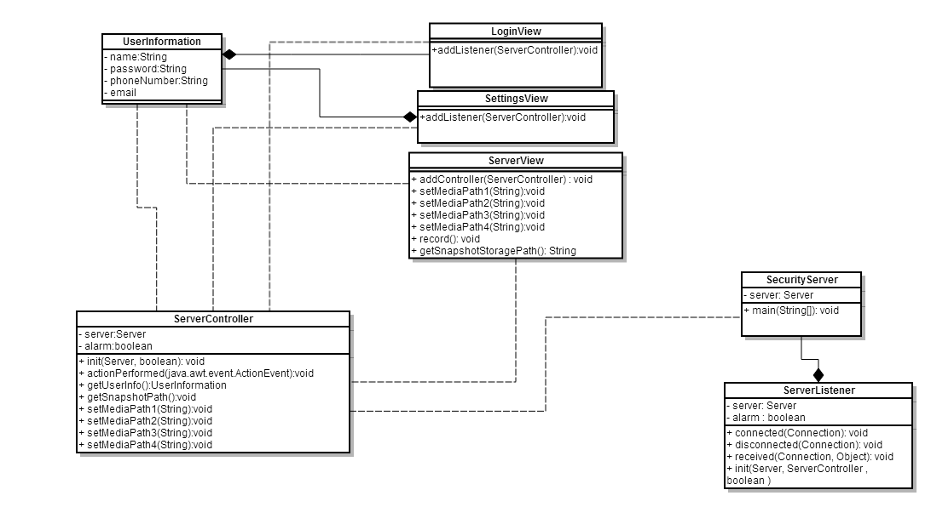
Server Gui – Server side class diagram

Slide 7
Server gui- mvc technique
The Java server has been implemented using the MVC(Model, View, Controller) technique.
“SecurityServer” class plays the role of the Model, as it is the backbone of the server’s backend operation
“ServerController” class plays the role of the Controller, which performs all the event listening options of the View, and interfacing between the View and the Model
ServerView class plays the role of the View, which implements the display.

Slide 8
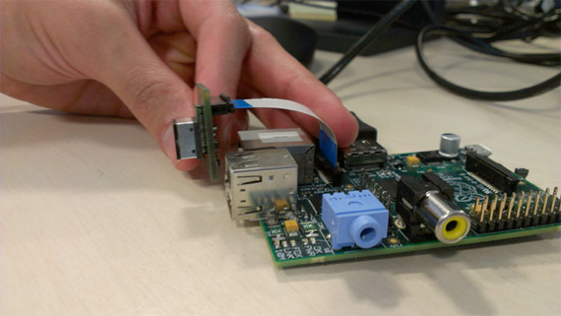
Client modules- camera
The Pi Camera as seen below is connected directly to the Raspberry Pi

Slide 9
Client Module – camera and PIR Motion sensor
As previously stated, this is connected to the Raspberry Pi directly.
The Raspberry Pi also holds the PIR Motion Sensor which is connected through the Gertboard(shown in next slide)
CameraClient class, handles the connection to the server and all camera and motion detector implementation
Below is the command line instruction called to stream video via vlc to the server: raspivid -o - -w 920 -h 540 -t 0 |cvlc -vvv stream:///dev/stdin --sout '#rtp{sdp=rtsp://:8554/}' :demux=h264

Slide 10
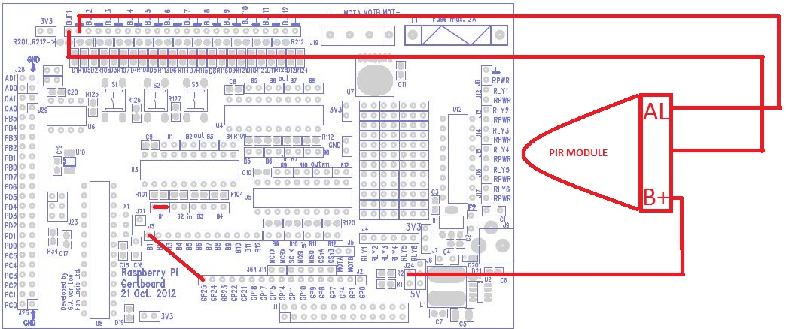
Client module – pir motion sensor
PIR Module wiring diagram

Slide 11
Client module – alarm module
AlarmClient class initiates connection to server
AlarmClient is run directly on the Raspberry Pi, a speaker is connected directly to RPi to play sound
Below is the command line instruction called to play alarm sound when Alarm client receives an Alert
aplay alarm.wav

Slide 12
External Software/libraries used
For seamless client/server socket communication:
Kryonet networking library[kryonet-debug-2.18-all.jar]
For dynamic SMS messaging functionality:
Ozeki SMS Gateway and Client Software[OzekiSmsClient.jar]
For Email functionality:
Java Activation Framework(jaf 1.1)[activation.jar]
JavaMail API[mail.jar]
For video streaming from Pi Camera to view in server:
VLC Media Player [vlcj-2.4.1.jar]

Slide 13
milestones
1. Server and client communication, (sending/receiving mock data from clients) make skeleton of client COMPLETED
2. I/O modules and their respective connections to their PI COMPLETED
3. Server and client communication with PI's having actual live I/O from camera/motion COMPLETED
4. Server GUI, Phone and email alert COMPLETED
5. If time is willing, attach motor to camera module to rotate it. NOT COMPLETED

Slide 14
POSSIBLE future ADDITIONS/changes to system
Motor could be added to rotate camera
MMS could be used to send images as text message to home owner. (Not implemented because a GSM modem with AT commands supported needed and we realized late)
Android app could have been developed to handle receipt of image and control the server.
Silent alarm(i.e. only Flashes lights) could be implemented with the use of PiFace I/O board

